Slide 1
R-03B BOM ID Change to Avoid Disabling TMON After R-03A
NVL-S RVP
Required Rework Document

Slide 2
R-03B
BOM ID Change to Avoid Disabling TMON After R-03A
Change Log | 2025 WW37-Initial
Description | Change BOM ID to 000 (from 011) to prevent TMON from being disabled by default after performing R-03A.
Impact | Without this rework, TMON will remain disabled by default, even after applying the R-03A rework.
Rework Involved | SMD Resistors
SKUs | S011-P8AZ04, S021-P8AZ03
Contacts | Wang, Ivan B
HSD Link | https://hsdes.intel.com/appstore/article-one/#/article/22021410780
Collateral Link | N/A
SW Dependency | Please ensure the TMON is enabled in BIOS menu after completing this rework. Intel Advance Menu → Power and Performance → CPU Power Management Control → CPU VR settings Performance Core VR settings → TMON → Enable GT VR settings → TMON → Enable SA VR settings → TMON → Enable

Slide 3
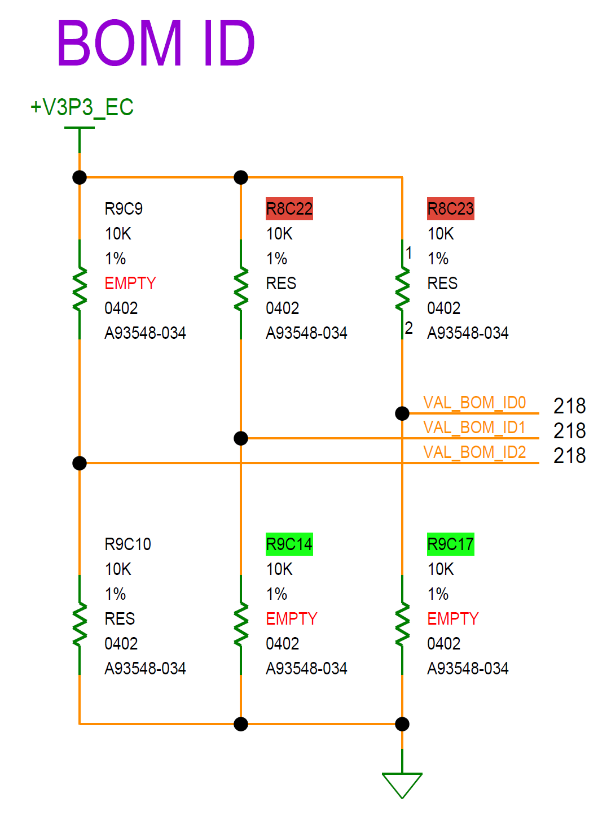
S011/S021 TOP

Slide 4
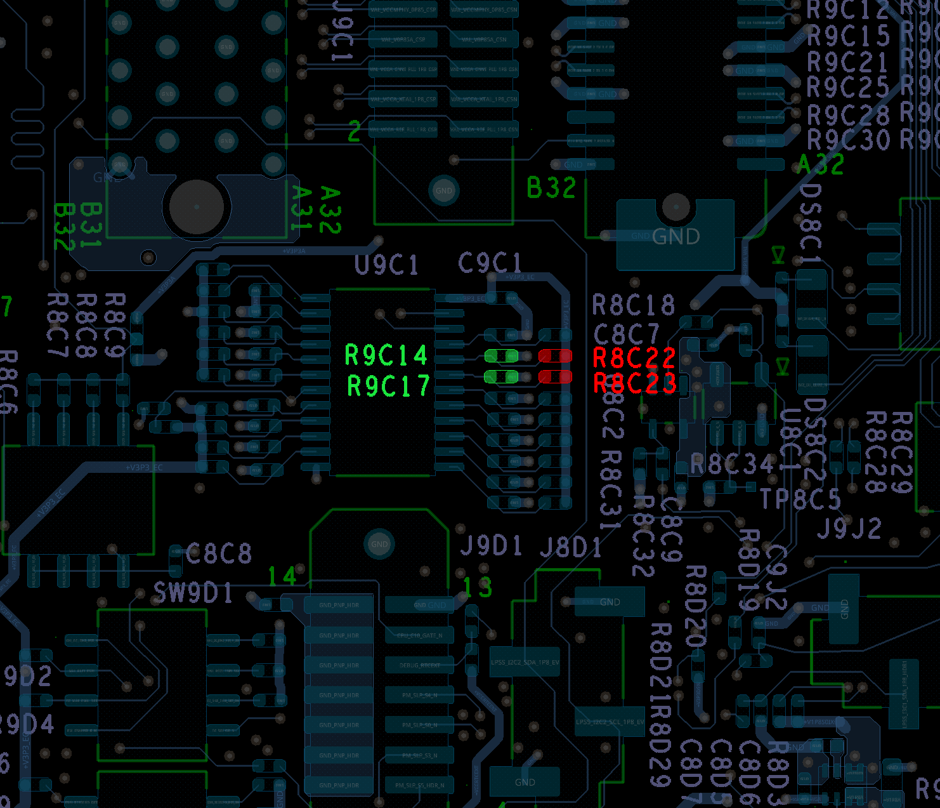
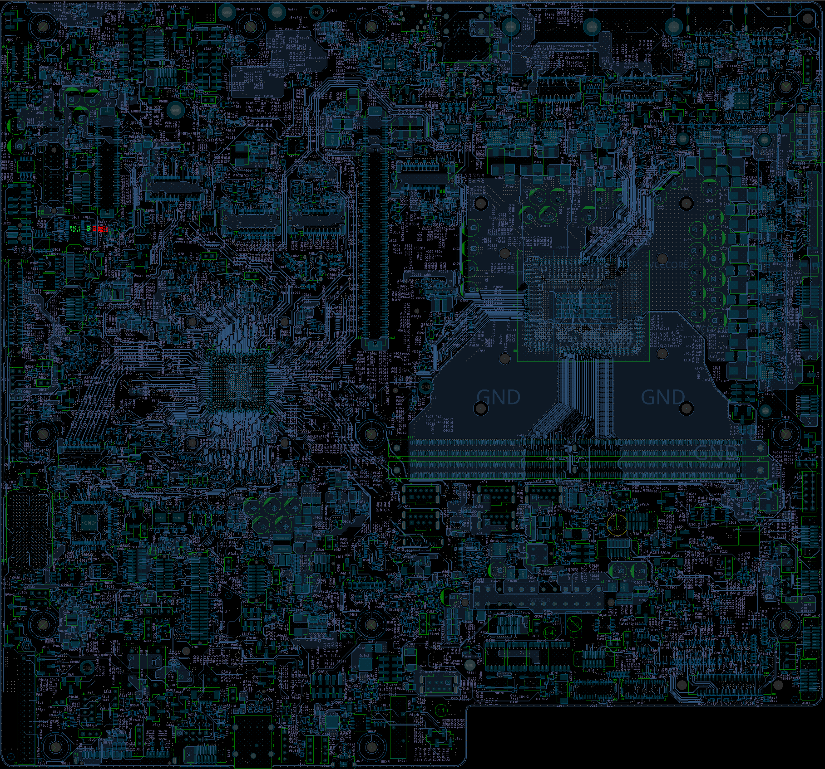
S011/S021
Step 1 of 1
Action | REFDES | Description
UNSTUFF | R8C22 | RES,0402,10k OHM,1/16W
UNSTUFF | R8C23 | RES,0402,10k OHM,1/16W
STUFF | R9C14 | RES,0402,10k OHM,1/16W
STUFF | R9C17 | RES,0402,10k OHM,1/16W
TOP

Slide 5
S011/S021
R-03B BOM ID Change to Avoid Disabling TMON After R-03A
Rework Summary
Action | Item | REFDES | Current IPN | Description | New IPN | Description
UNSTUFF | Resistor | R8C22 | A93548-034 | RES_D,0402,10.00kOHM,1.00%,1/16W | NA | NA
UNSTUFF | Resistor | R8C23 | A93548-034 | RES_D,0402,10.00kOHM,1.00%,1/16W | NA | NA
STUFF | Resistor | R9C14 | NA | NA | A93548-034 | RES_D,0402,10.00kOHM,1.00%,1/16W
STUFF | Resistor | R9C17 | NA | NA | A93548-034 | RES_D,0402,10.00kOHM,1.00%,1/16W

